Slide 1
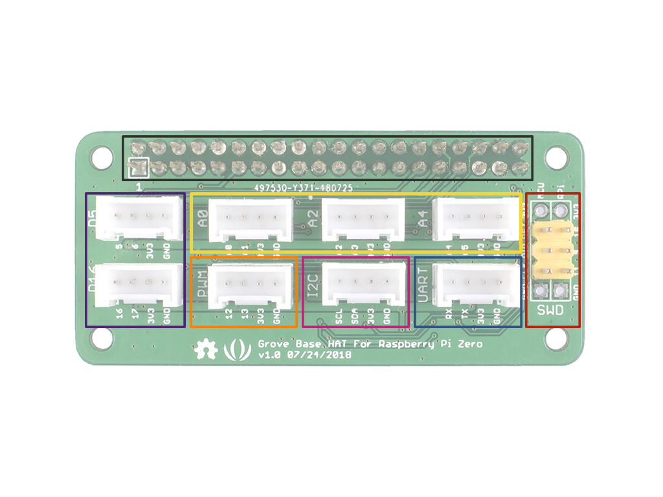
GPIO
Analog
Digital
GPIO
SWD
PWM
I2C
UART

